Slide 1
Cache Consistency - Memcached at Facebook
Lecturer: Ngo Huy Bien
Software Engineering Department
Faculty of Information Technology
VNUHCM - University of Science
Ho Chi Minh City, Vietnam
nhbien@fit.hcmus.edu.vn

Slide 2
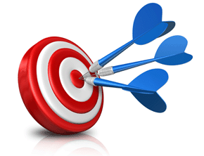
Objectives

Slide 3

Contents

Slide 4

References
http://nil.csail.mit.edu/6.824/2020/schedule.html

Slide 5
why are we reading this paper?
it's an experience paper, not about new ideas/techniques
three ways to read it:
cautionary tale about not taking consistency seriously from the start
impressive story of super high capacity from mostly-off-the-shelf s/w
fundamental struggle between performance and consistency
we can argue with their design, but not their success

Slide 6
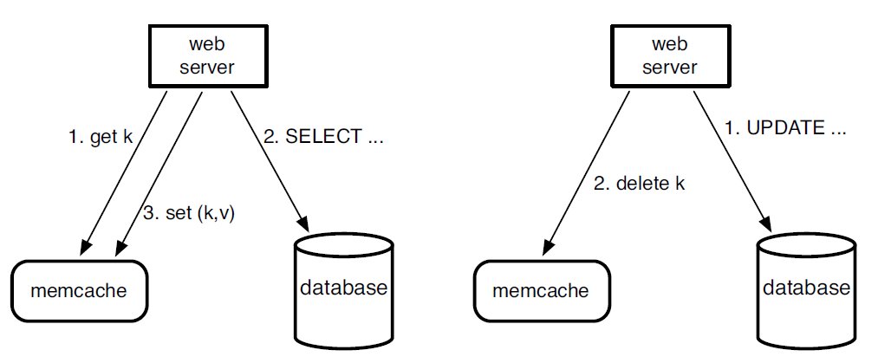
how do FB apps use mc?
FB uses mc as a "look-aside" cache
real data is in the DB
cached value (if any) should be same as DB
read:
v = get(k) (computes hash(k) to choose mc server)
if v is nil {
v = fetch from DB
set(k, v)
}
write:
v = new value
send k,v to DB
delete(k)
application determines relationship of mc to DB
mc doesn't know anything about DB
The left half illustrates the read path for a web server on a cache miss.
The right half illustrates the write path.

Slide 7
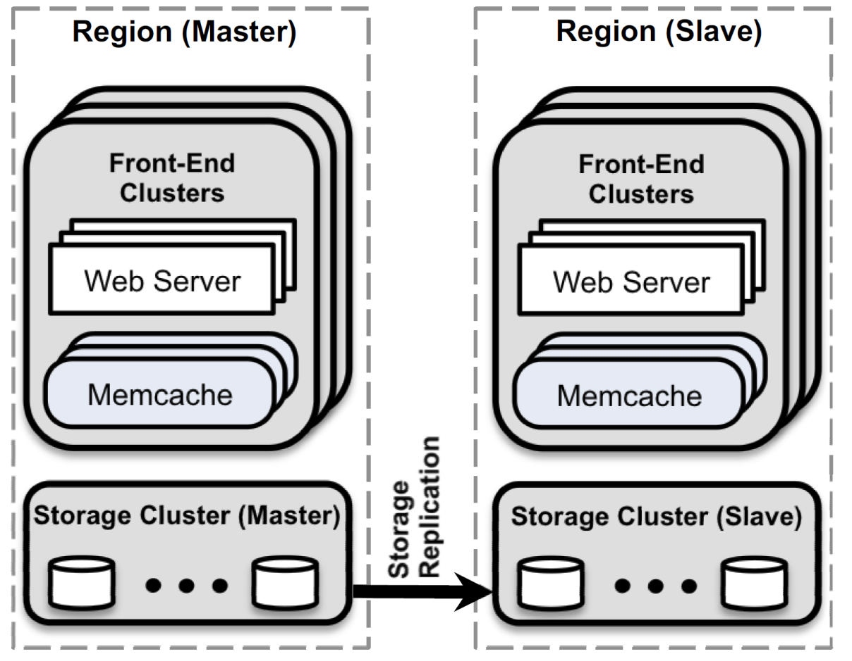
architecture

Slide 8
Parallel requests and batching
We structure our web application code to minimize the number of network round trips necessary to respond to page requests.
We construct a directed acyclic graph (DAG) representing the dependencies between data.
A web server uses this DAG to maximize the number of items that can be fetched concurrently.

Slide 9
Construct a Directed Acyclic Graph
DAG Structure: The idea is to represent your data and their dependencies as a graph, where each node represents a data resource or item, and edges represent dependencies between these resources.
In a DAG, there are no cycles, meaning no data can depend on itself.
How to Construct: You can create the DAG programmatically by:
Identifying Resources: First, identify all the data that needs to be fetched from the server.
Defining Dependencies: For each data point, identify what data it depends on. For example, if you need to fetch a list of user comments, you may first need to fetch user details.
Graph Representation: You could use libraries like networkx (Python) or graphlib to model this graph.

Slide 10
Example
{
"nodes": [
{ "id": "user_data", "dependencies": [] },
{ "id": "posts_data", "dependencies": ["user_data"] },
{ "id": "comments_data", "dependencies": ["posts_data"] }
]
}

Slide 11
Resolve Dependencies (Topological Sorting)
Topological Sort: Once you’ve created the graph, you’ll need to resolve the dependencies.
A topological sort of the DAG ensures that data is fetched in the correct order, i.e., you’ll fetch the independent data first, then fetch dependent data later.
Libraries like networkx in Python can help perform topological sorting.

Slide 12
Make Parallel Requests
Once you have the sorted nodes, you can start making requests. Any data that has no dependencies can be requested concurrently. For dependent data, ensure that the necessary data has been fetched before making the request.
Parallel Fetching: To fetch data concurrently, use asynchronous calls (e.g., using asyncio in Python or Promise.all() in JavaScript). You can group independent requests together and run them in parallel to save time.

Slide 13
Client-server communication
Memcached servers do not communicate with each other. When appropriate, we embed the complexity of the system into a stateless client rather than in the memcached servers.
This greatly simplifies memcached and allows us to focus on making it highly performant for a more limited use case.
Keeping the clients stateless enables rapid iteration in the software and simplifies our deployment process.
Client logic is provided as two components: a library that can be embedded into applications or as a standalone proxy named mcrouter.
This proxy presents a memcached server interface and routes the requests/replies to/from other servers.

Slide 14
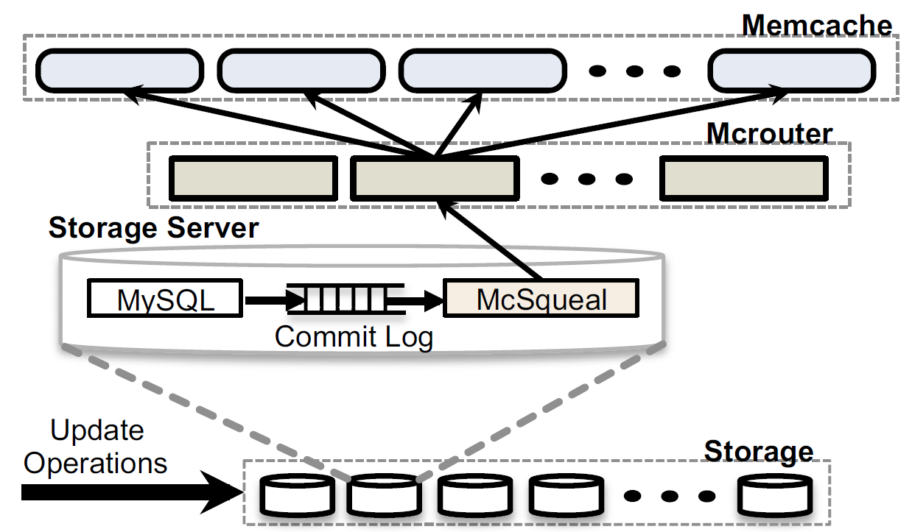
invalidation daemons
SQL statements that modify authoritative state are amended to include memcache keys that need to be invalidated once the transaction commits.
We deploy invalidation daemons (named mcsqueal) on every database.
Each daemon inspects the SQL statements that its database commits, extracts any deletes, and broadcasts these deletes to the memcache deployment in every frontend cluster in that region.

Slide 15


Slide 16
will partition or replication yield most mc throughput?
partition: divide keys over mc servers
replicate: divide clients over mc servers
partition:
+ more memory-efficient (one copy of each k/v)
+ works well if no key is very popular
- each web server must talk to many mc servers (overhead)
replication:
+ good if a few keys are very popular
+ fewer TCP connections
- less total data can be cached

Slide 18
bringing up new mc cluster is a performance problem
new cluster has 0% hit rate
if clients use it, will generate big spike in DB load
if ordinarily 1% miss rate,
adding "cold" second cluster will causes misses for 50% of ops.
i.e. 50x spike in DB load!
thus the clients of new cluster first get() from existing cluster (4.3)
and set() into new cluster
basically lazy copy of existing cluster to new cluster
better 2x load on existing cluster than 30x load on DB

Slide 19
another overload problem: thundering herd
one client updates DB and delete()s a key
lots of clients get() but miss
they all fetch from DB
they all set()
not good: needless DB load
mc gives just the first missing client a "lease"
lease = permission to refresh from DB
mc tells others "try get() again in a few milliseconds"
effect: only one client reads the DB and does set()
others re-try get() later and hopefully hit

Slide 21
what is their consistency goal?
writes go direct to primary DB, with transactions, so writes are consistent
what about reads?
reads do not always see the latest write
e.g. since not guaranteed across clusters
more like "not more than a few seconds stale"
i.e. eventual
*and* writers see their own writes (due to delete())
read-your-own-writes is a big driving force

Slide 22
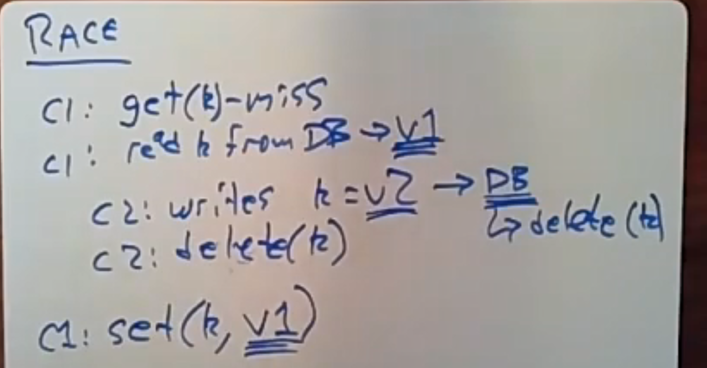
Race

Slide 23
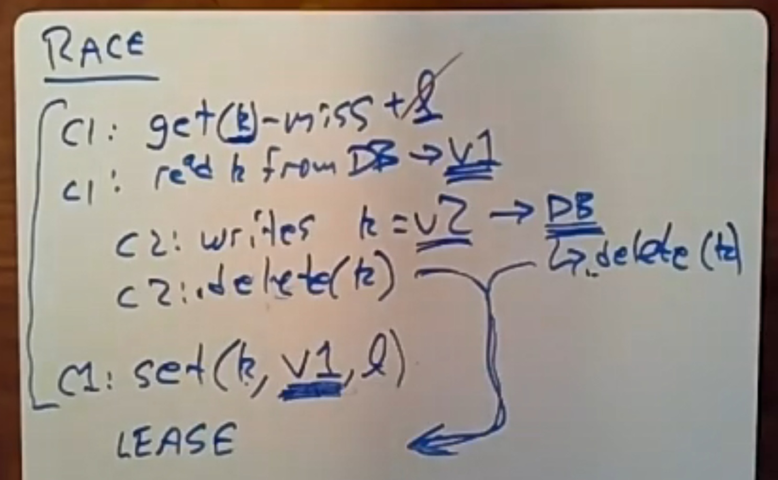
Lease: Solution for Race

Slide 24

Thank You & See You Again

